Slide 1
BDM 3014 Project Book Recommendation Engine
Presented by:
Jefford Secondes
Jovi Fez Bartolata
Maricris Resma
Luz Zapanta

Slide 2
Agenda
Objectives
Methodology
Data Processing and Exploratory Data Analysis
Recommendation Engines

Slide 3
Objectives
The project aims to build a recommendation engine that can be used to suggest books that are more relevant to the users
To create content-based recommendations engines using single and a combination of multiple attributes

Slide 4
Methodology

Slide 5
Methodology
Data Gathering
Data Pre-Processing
Reco Engine Creation
Exploratory Data Analysis

Slide 6
Data Gathering
Data Source: Kaggle
https://www.kaggle.com/datasets/bahramjannesarr/goodreads-book-datasets-10m/code?select=user_rating_6000_to_11000.csv
12 Variables
Name – The name/title of the book.
Authors – The name of the author of the book.
Language – The language in which the book is written.
PagesNumber – a unique identifier for each book in the dataset.
Rating – Average user ratings for the book
CountsofReview – The number of reviews that a particular book has received.
Id – A unique identifier for each book in the dataset.
PublishYear – The year on which the book was published.
PublishMonth – The month on which the book was published.
PublishDay – The day on which the book was published.
ISBN – (International Standard Book Number) It is a unique identifier assigned to each edition and variation of a book.
Publisher – The name of the publisher of the book.

Slide 7
Data Pre-Processing, Exploratory Data Analysis (EDA)
Data Pre-Processing
Refers to the process of collecting, cleaning, integrating, transforming and normalizing data in order to build an accurate and effective recommendation model.
Exploratory Data Analysis (EDA)
EDA helps to gain insights into the underlying structure of the dataset and identify important features or variables that can be used to build an accurate recommendation model. It is an important step in the data analysis process that involves visualizing and summarizing the main characteristics of the dataset.

Slide 8
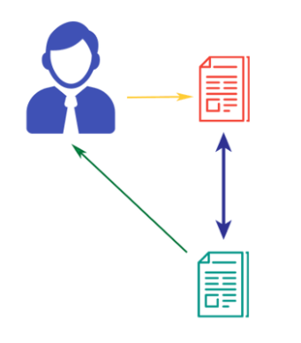
Content-Based Recommendation Engine
Content-based Recommendation Engine is a type of recommendation system that suggests items to users based on their past interactions with similar items. It can be done by using a single attribute or a combination of attributes.
Using A Single Attribute – e.g. Author or Language
Using A Combination of Attributes – e.g. using K Nearest Neighbors (KNN)
Read by User
Similar
Books
Recommended to User

Slide 9
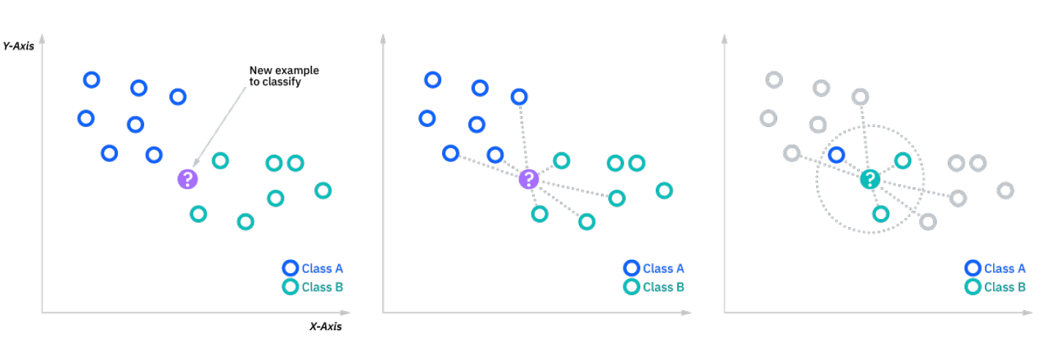
K-Nearest Neighbors (KNN)
K-Nearest Neighbors (KNN) is a non-parametric, supervised learning classifier, which uses proximity to make classifications or predictions about the grouping of an individual data point.

Slide 10
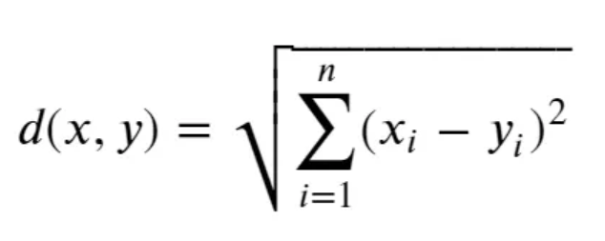
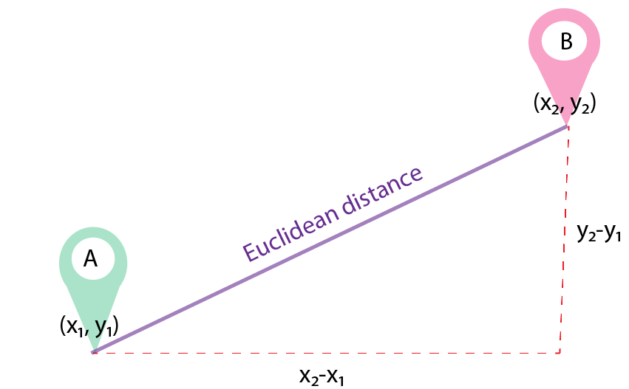
K-Nearest Neighbors (KNN)
Euclidean Distance: One of the commonly used distance measures. It measures a straight line between the query point and the other point being measured.
Formula:
https://miro.medium.com/v2/resize:fit:2678/1*yjxwoNqIwb1fXW26HvK_Kw.png

Slide 11




K-Nearest Neighbors (KNN)
Illustration: Suppose we want 1 nearest neighbor from the Red point, we will get Green point.
Given: Red point in (3,3) and Green point in (1,1)
Formula:
Distance =
=
=
=
=
$$\sqrt{{\left(3−1\right)}^{2}+{\left(3−1\right)}^{2}}$$
$$\sqrt{{\left(2\right)}^{2}+{\left(2\right)}^{2}}$$
$$\sqrt{4+4}$$
$$\sqrt{8}$$
2.83

Slide 12
K-Nearest Neighbors (KNN)
Feature Scaling Using MinMaxScaler()
This estimator scales and translates each feature individually such that it is in the given range on the training set, e.g. between zero and one.
Ball Tree Algorithm
The total space of training data is divided into multiple balls (circular blocks), and the distance of testing data is calculated only with the training points in that block instead of calculating with all the training data points.

Slide 13
Data Pre-Processing and Exploratory Data Analysis

Slide 14
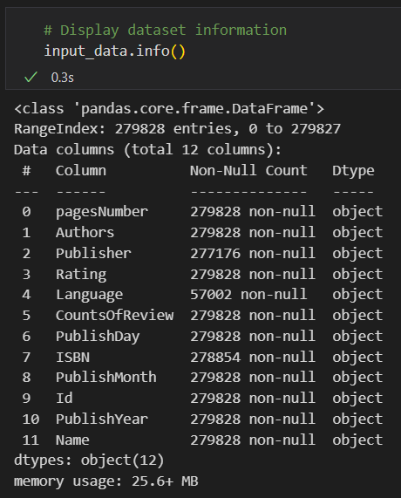
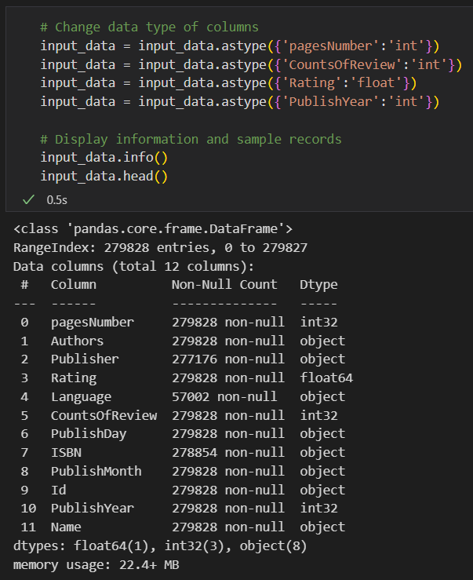
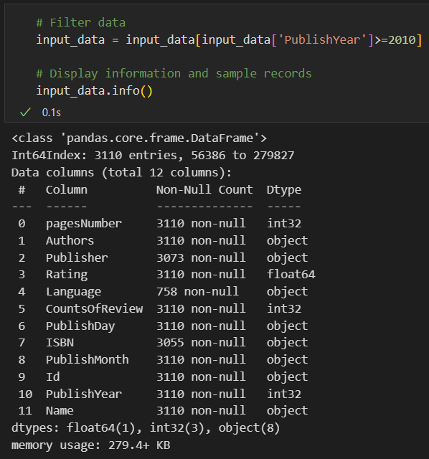
Data Pre-Processing

Slide 15
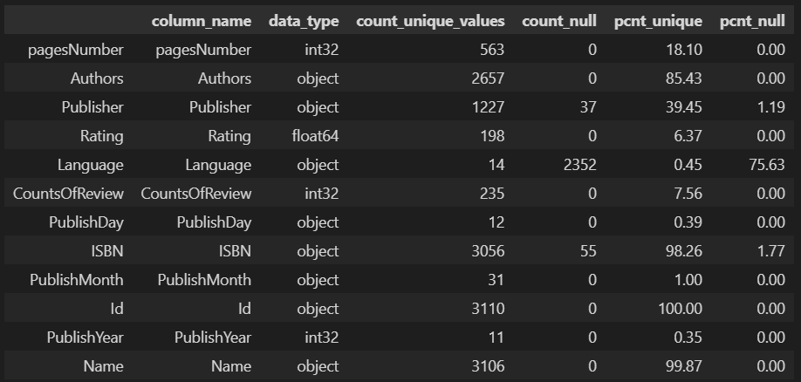
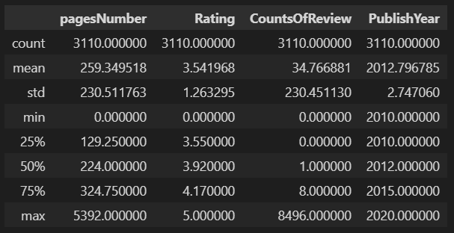
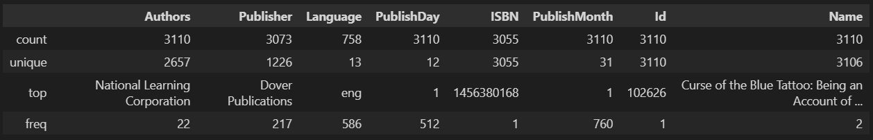
Data Pre-Processing
Summary of Features

Slide 16
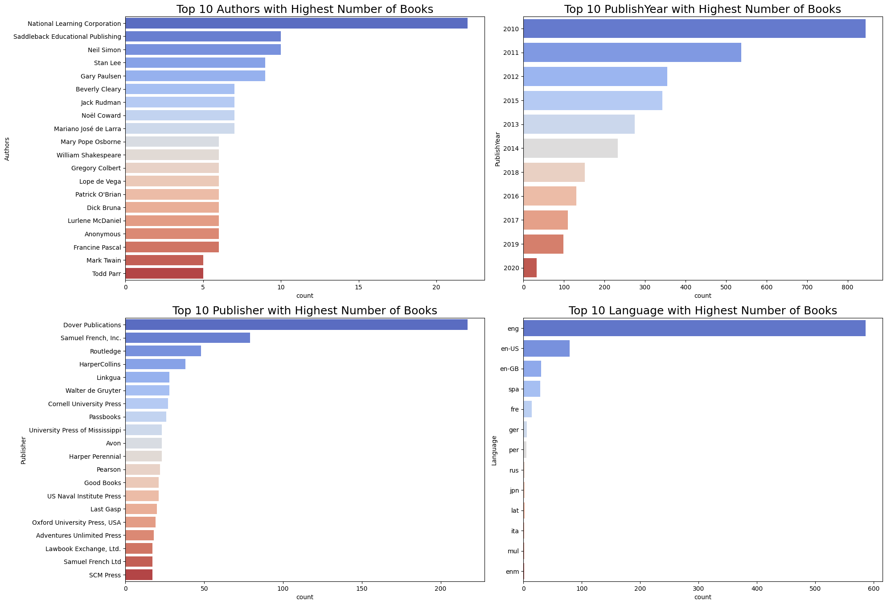
Exploratory Data Analysis
National Learning Corporation is the top author in terms of book count from 2010 to 2020.
Most books are from 2010 publication year.
Majority of the books were published by Dover Publications.
English (eng) is the most popular language used in the books.

Slide 17
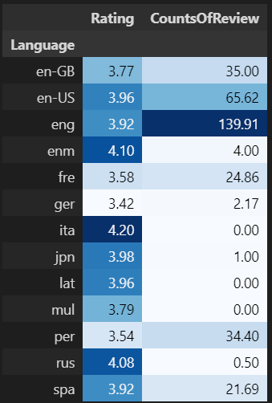
Exploratory Data Analysis
English books have the highest average review count at 139.91.
Books written in Italian have the highest average rating at 4.20.

Slide 18
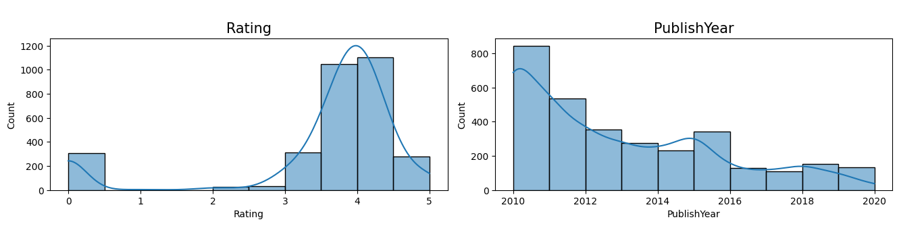
Exploratory Data Analysis
Rating is negatively skewed i.e., majority of books have higher ratings. However, there are some with a rating of zero (0).
PublishYear is positively skewed i.e., the data contains older books (published around 2010) compared to latest books.

Slide 19
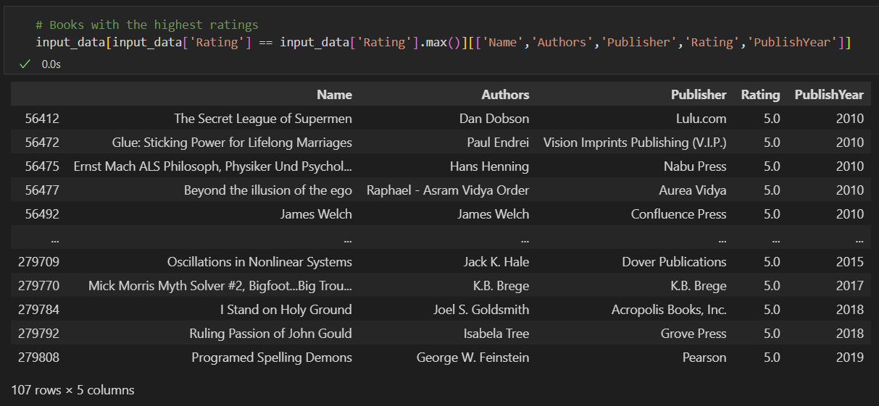
Exploratory Data Analysis
Some of the highest rated books are The Secret League of Supermen by Dan Dobson, Glue: Sticking Power for Lifelong Marriages by Paul Endrei, and Programed Spelling Demons by George W. Feinstein.

Slide 20
Recommendation Engines

Slide 21
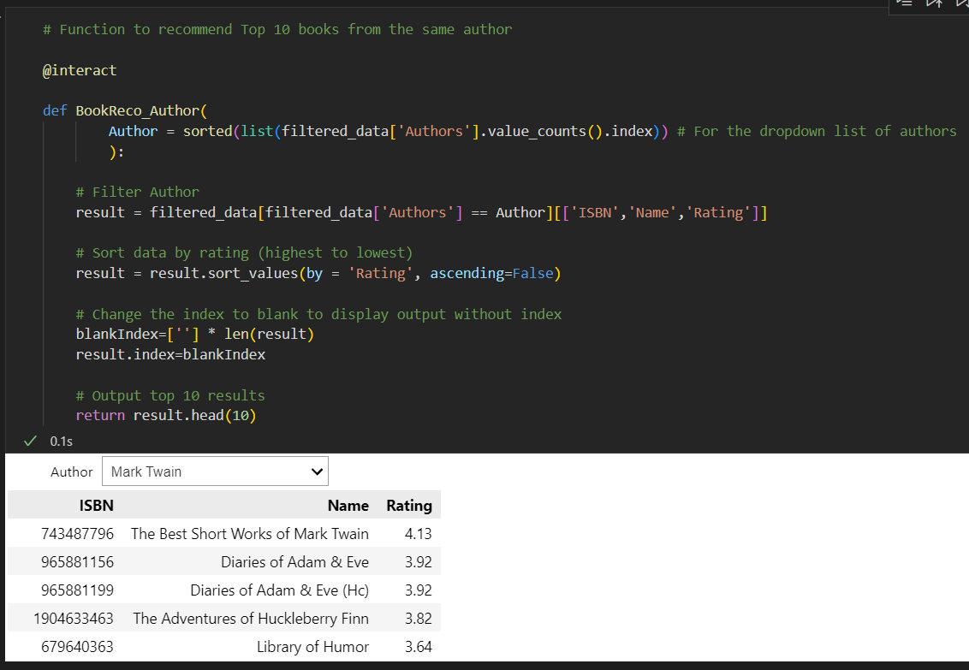
Book Recommendation Based on a Single Attribute
Book Recommendation Based on Author

Slide 22
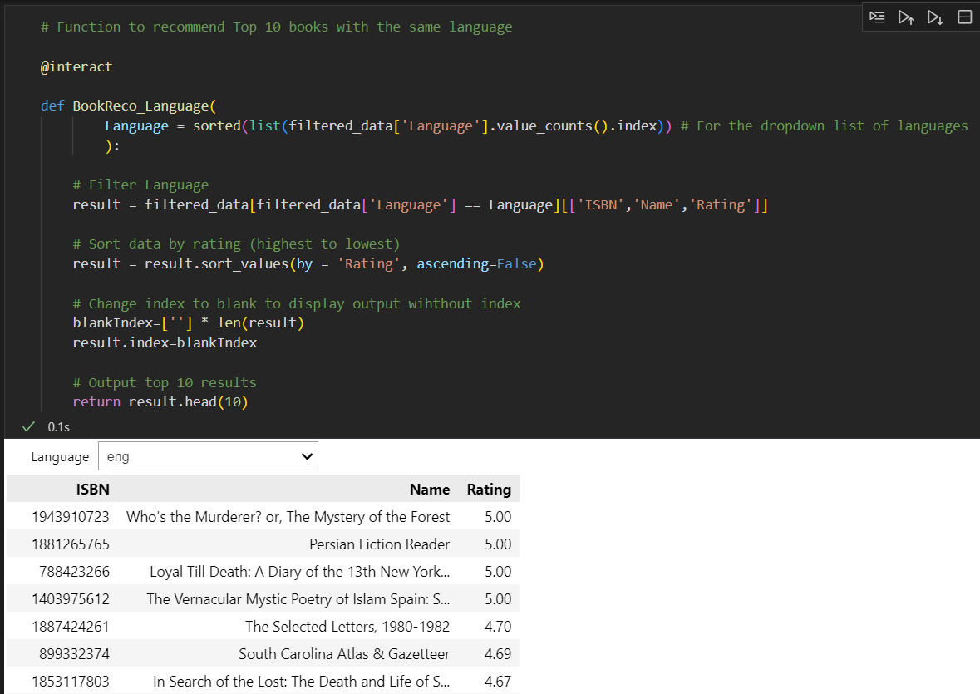
Book Recommendation Based on a Single Attribute
Book Recommendation Based on Language

Slide 23
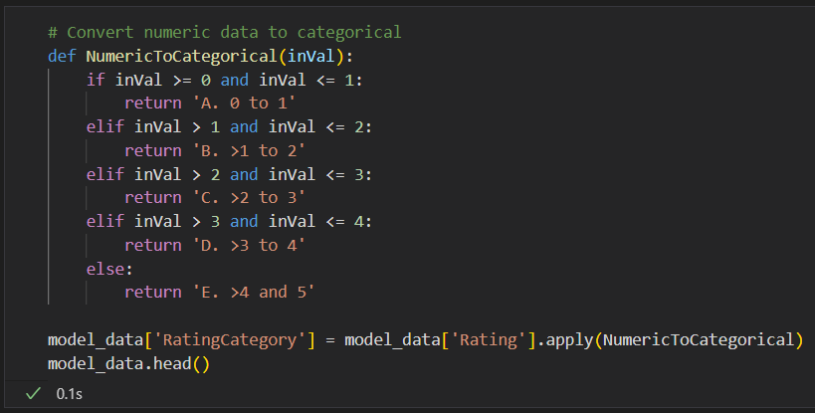
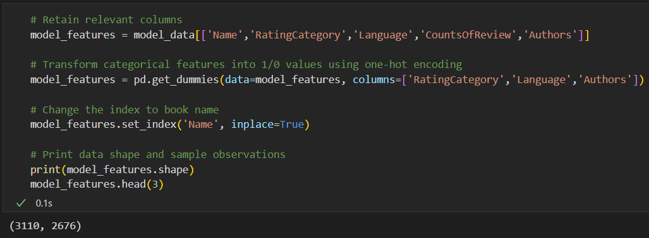
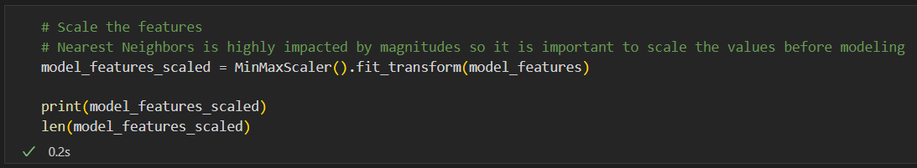
Book Recommendation Using A Combination of Attributes
Data Processing: Change categorical features to numeric

Slide 24
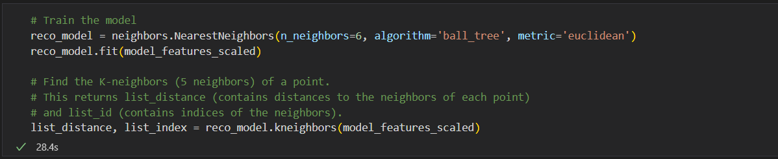
Book Recommendation Using A Combination of Attributes
Train the model using KNN and create a function to recommend 5 similar books

Slide 25

Book Recommendation Using A Combination of Attributes
Book recommendation based on popularity (rating, count of reviews) and language

Slide 26
Thank you.

Slide 27
References
https://www.ibm.com/topics/knn
https://medium.com/@luigi.fiori.lf0303/distance-metrics-and-k-nearest-neighbor-knn-1b840969c0f4
https://medium.com/@anuuz.soni/advantages-and-disadvantages-of-knn-ee06599b9336
https://www.kdnuggets.com/2020/11/most-popular-distance-metrics-knn.html

